Slide 1
June Update

Slide 2
What I have done

Slide 3
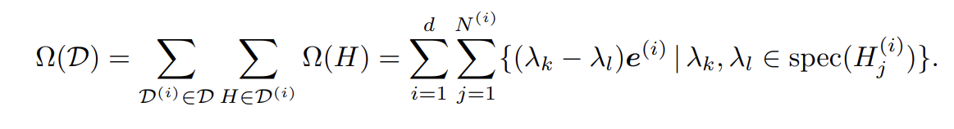
Generalized Trigonometric Polynomials
Notes:
From paper

Slide 4
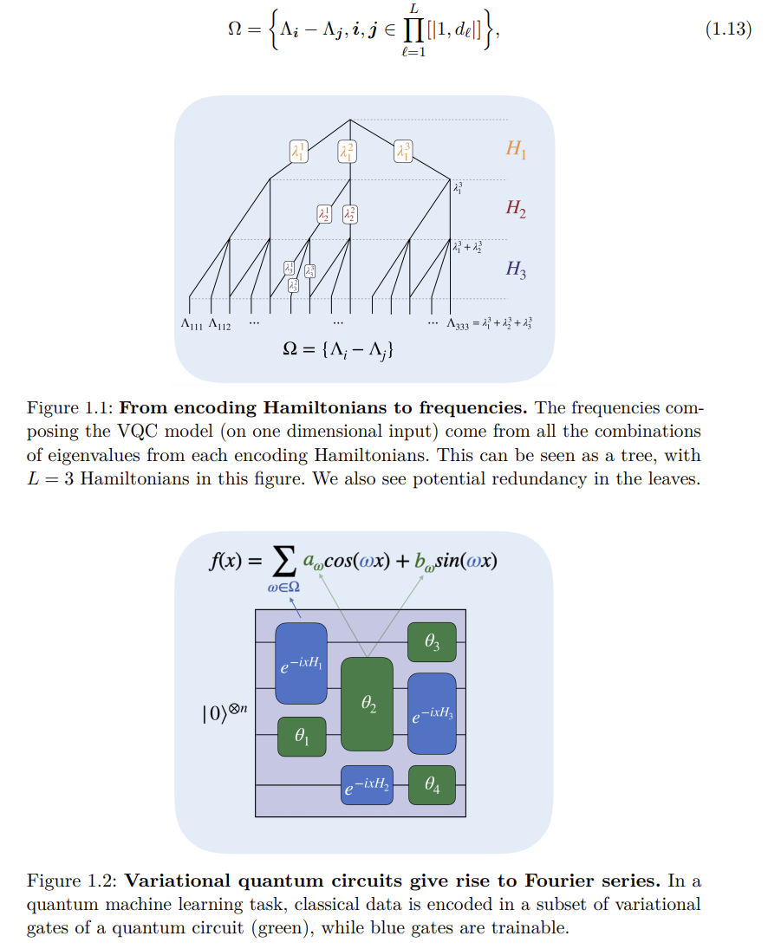
GTP continued
Notes:
From thesis intro

Slide 5

Parameter Shift Rule and bound on gradients
Notes:
From pennylane

Slide 6
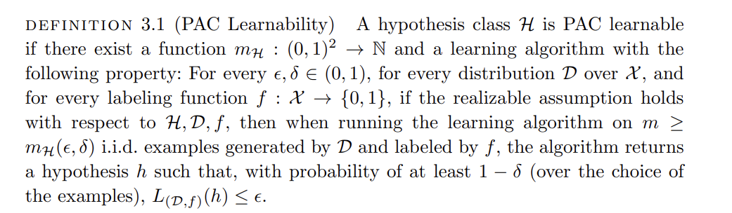
PAC Learning
Notes:
From understanding machine learning: From theory to algorithms book

Slide 7
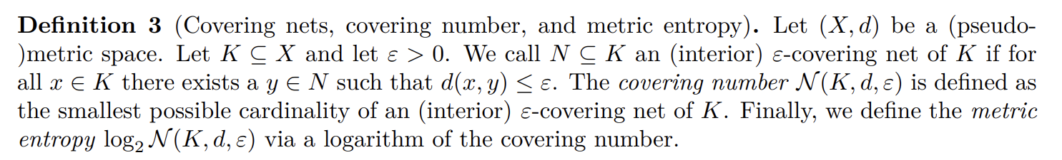
Covering Number(kind of)
Rademacher Complexity
Get upper bound on covering number and thus on Rademacher Complexity
Get bound
Notes:
From paper

Slide 8
Impossibility Result
Show hardness of learning
Assume efficient algo to learn concept class
This means adversary can use this algo as a subroutine to break some cryptographic construction
If the cryptographic construction is secure, learning algo cannot exist
Notes:
From paper

Slide 9
Things not finished
Bounding with covering numbers
Going through how to use covering numbers in the few training data paper
The paper with error
Reading the impossibility result in more detail

Slide 10
Logistics

Slide 11
The Form
Need to fill the form and submit

Slide 12
Future Meets
When?
What to aim for?

Slide 13
Things I will do

Slide 14
Resources
Things I did not finish
Understanding Machine Learning(Has a lot of topics mentioned including covering numbers) and High Dimensional Probability books
The Alice paper/draft thing
Any other papers related to the topic?
Any math topics/resources?
Any libraries? Also python?

